Slide 1
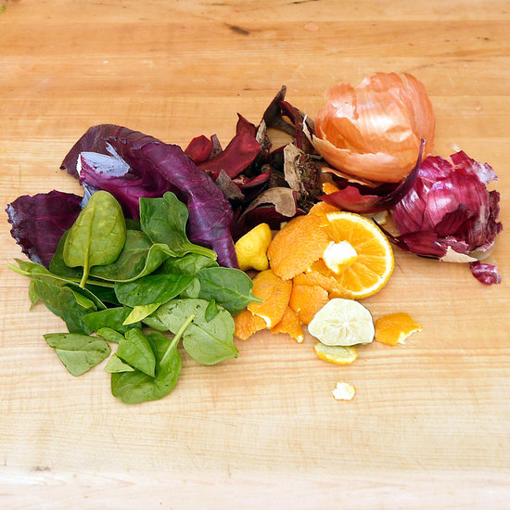
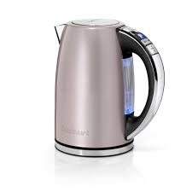
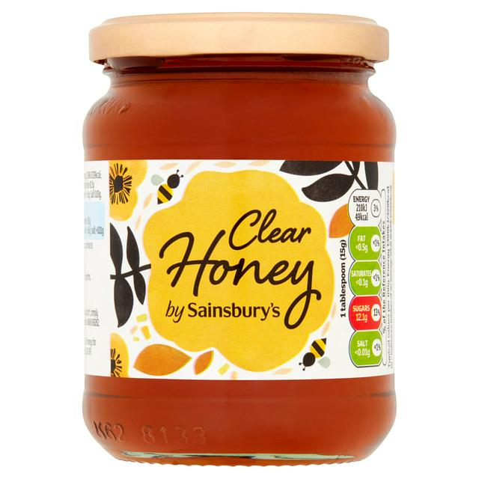
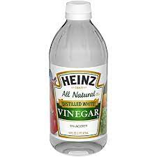
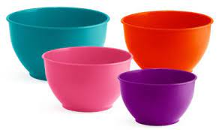
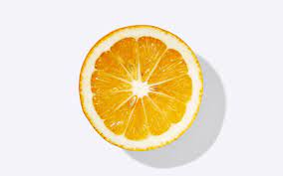
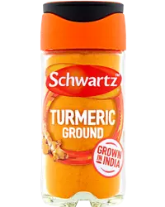
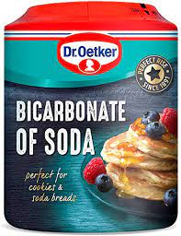
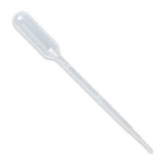
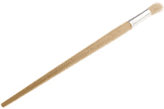
Kettle (ask your adult to help with this part)
card
Food scraps
water
Lemon juice
bowls
honey
vinegar
pipette
spices
Tea and coffee
Bicarbonate of soda
Paint brush
Notes:
A reminder for parents and carers – what your child(ren) will need for today's workshop
Play music as the children come in: Something like this MORNING MUSIC for Classroom - PLAYGROUND Music for Kids - Happy Mexican Traditional Music
https://www.youtube.com/watch

Slide 2
SAVE,
MAKE REINVENT
EXPLORING NATURAL INKS

Slide 3
Notes:
STEP 1: THE WELCOME (10 mins)
Introduction
Welcome: let's all share our first names
We are the Institute of Imagination.
What does imagination mean?
We think imagination is our super power!
How would you use your imagination as superpower to change the world?
Warm Up Game/Questions/Relaxation Technique

Slide 4
Test
Make
Experiment
Notes:
STEP 1: THE WELCOME (10 mins)
Introduction
At the Institute of Imagination we create, we test, we build, we try and try again, we make mistakes, we learn, and we explore.
Warm Up Game/Questions/Relaxation Technique

Slide 5
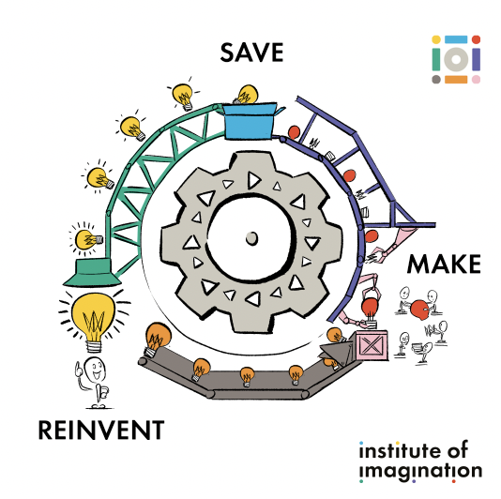
Notes:
STEP 2: THE TASTER (5 mins)
Theme & Context Setting
Introduction to theme: What are we doing today? Today we are exploring the theme Save Make Reinvent. Let’s break this down.
Save- We will be looking at ways that we save our food or household waste.
Make- We will be looking at what we can make out of waste
Reinvent- This is about thinking and experimenting with your imagination to come up with new ideas.

Slide 6
What do you think are the world’s biggest problems?
Notes:
STEP 2: THE TASTER (5 mins)
Theme & Context Setting
Introduction to theme: Let’s have a think about what it happening in the world today. What do you think are the world’s biggest problems?
If you're family are with you, tell your family your ideas and be ready to share your ideas with us in one minute!

Slide 7
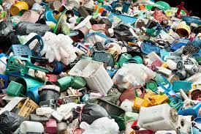
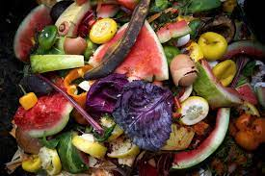
Notes:
STEP 2: THE TASTER (5 mins)
Theme & Context Setting
Introduction to theme: So let’s have a look at what people have done with their recycle products or food waste that we put in the bin.

Slide 9
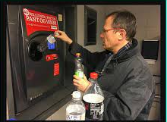
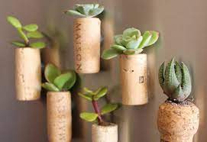
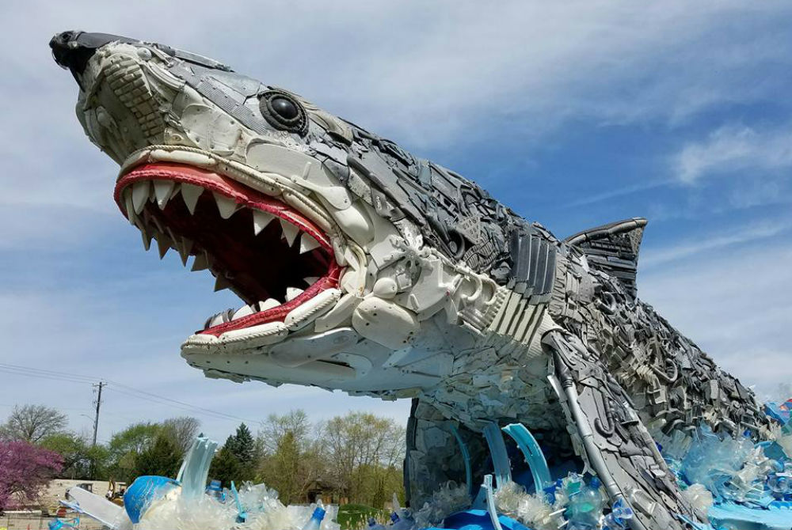
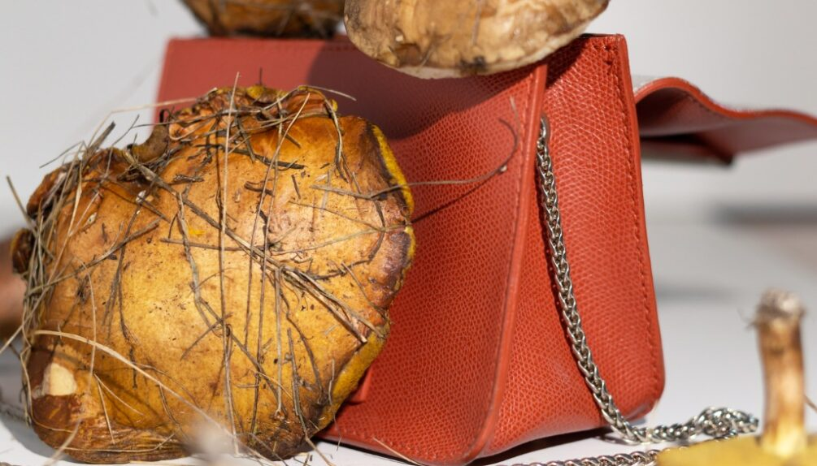
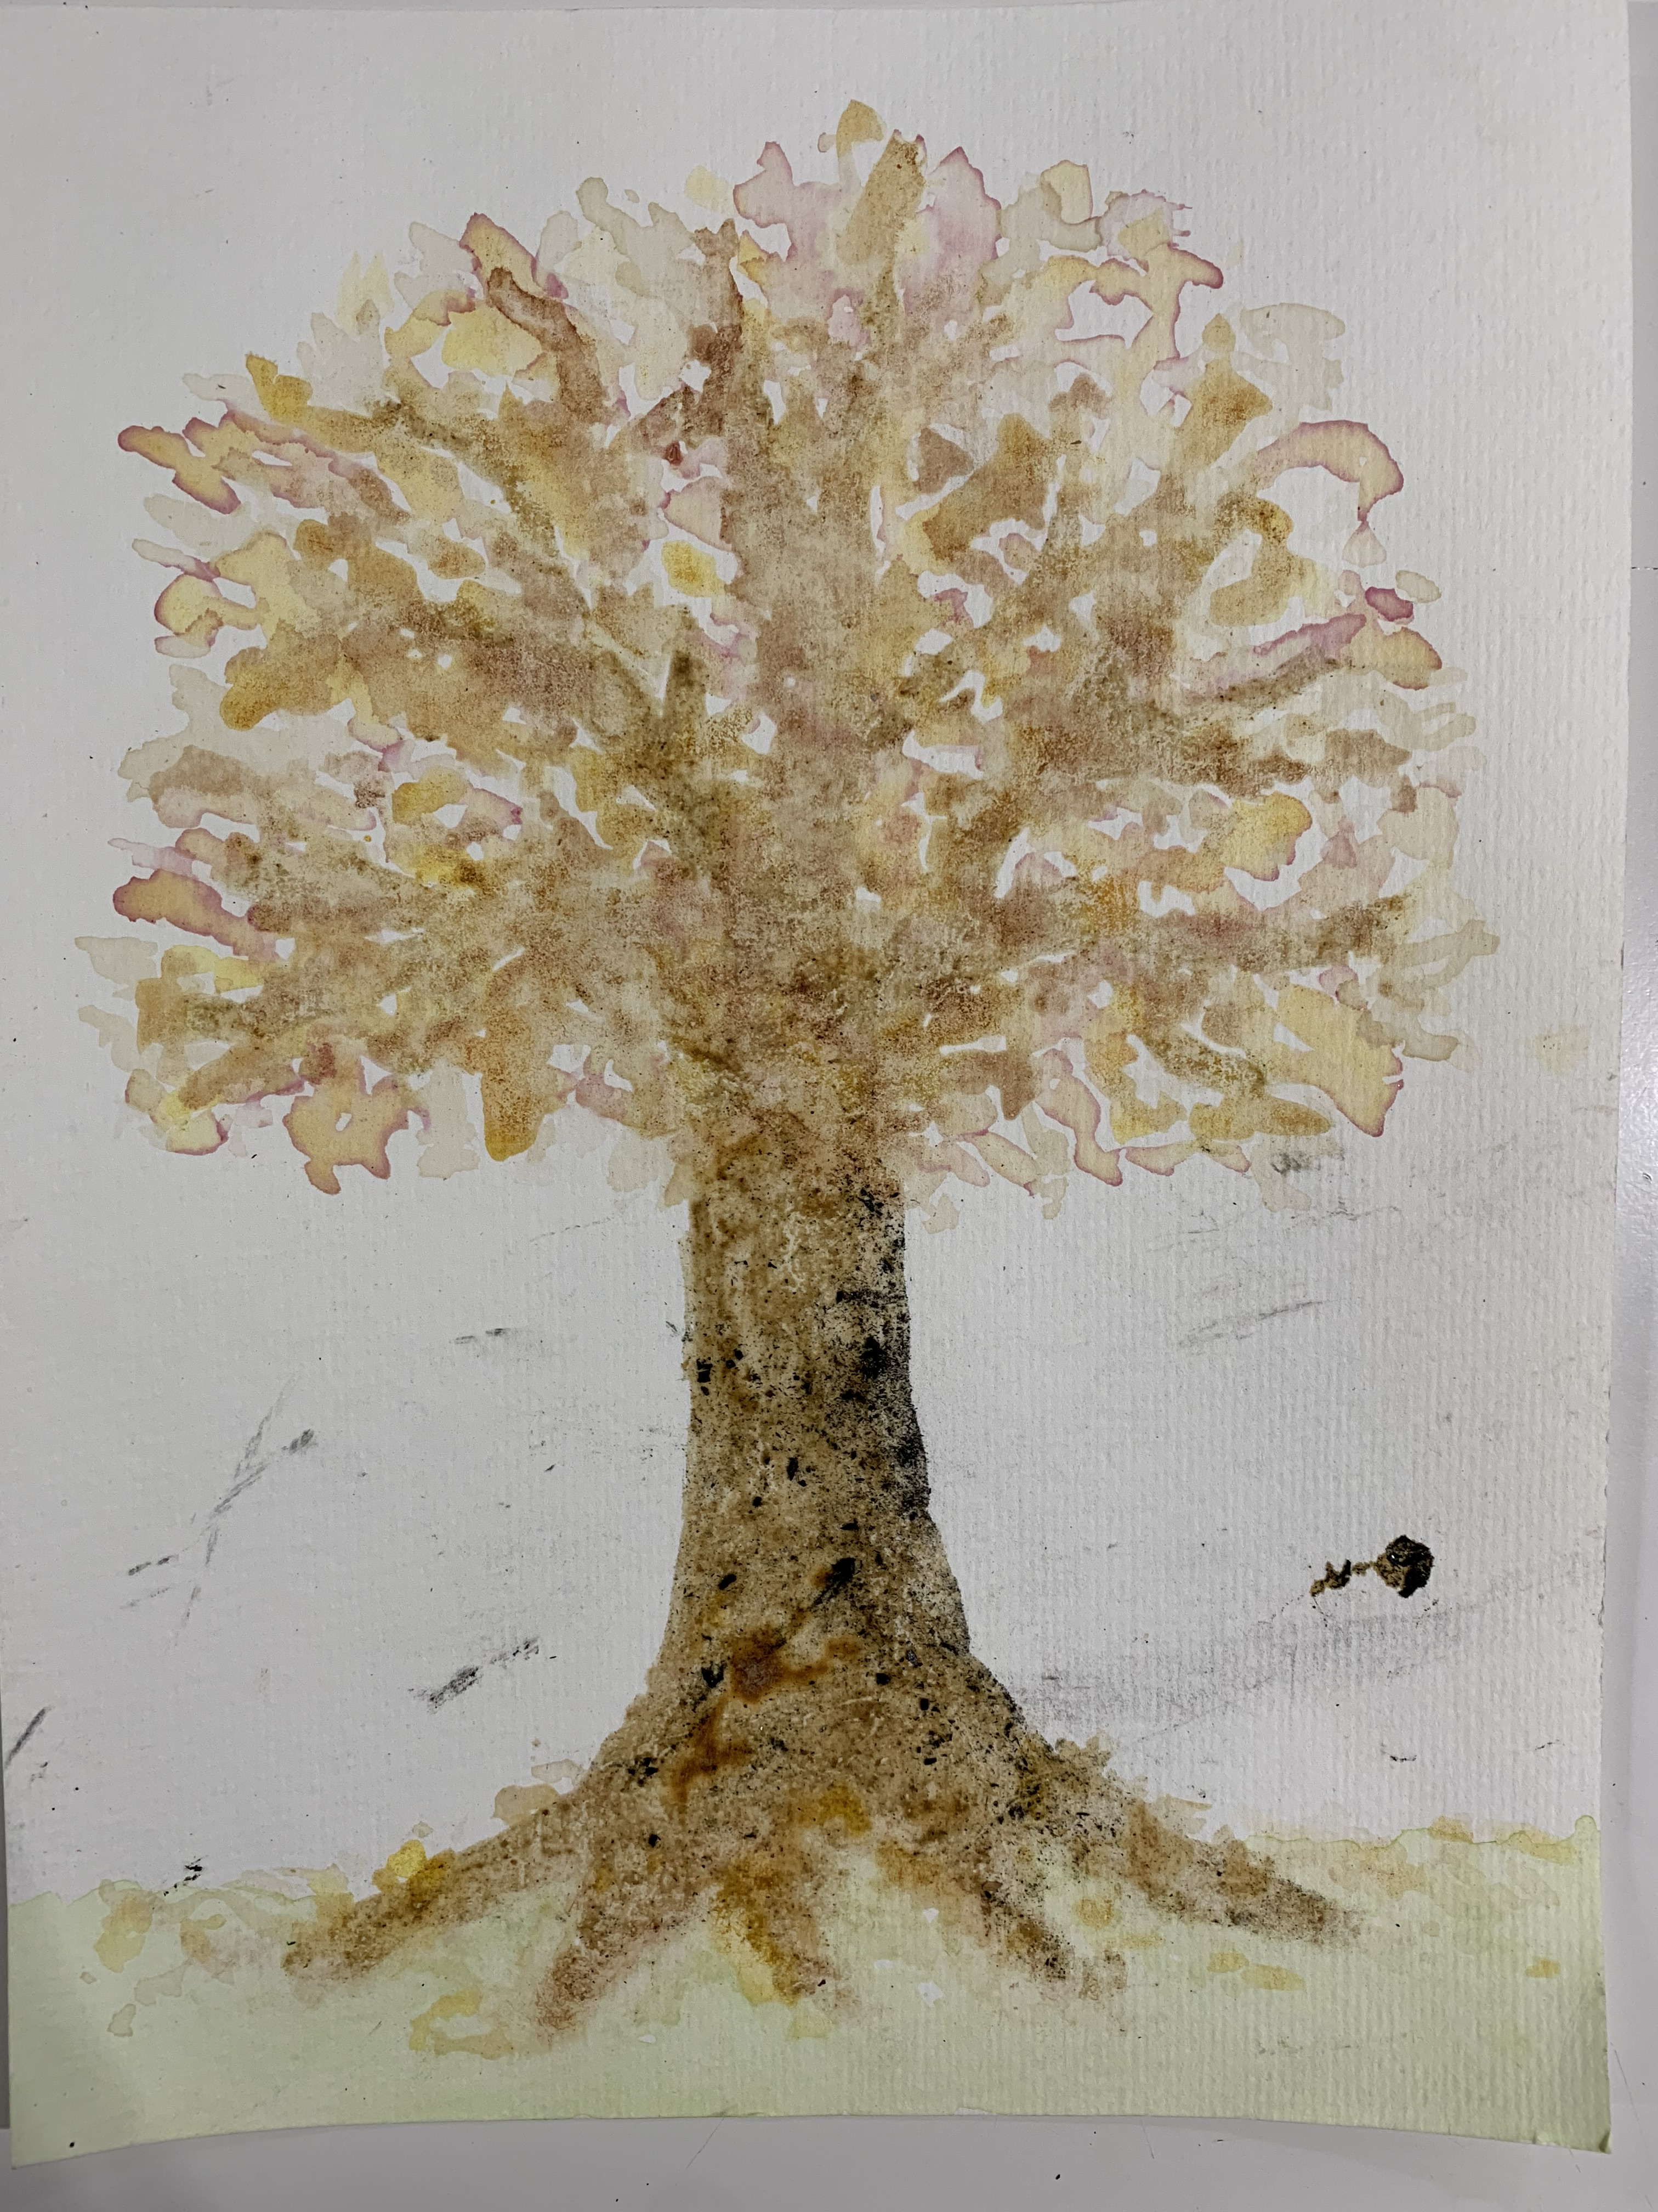
Notes:
STEP 2: THE TASTER (5 mins)
Theme & Context Setting
Let’s have a look at some of the ideas people have done to do something about ci
Picture 1: Machine they have invented in Norway that pay you to recycle your bottles
Picture 2. Corks as pots
Picture 3. Straws made flipflops
Picture 4. Sea waste make arty sculptures
Picture 5. Made from mushroom root, mycelium is a fibrous material that can be weaved to create mushroom leather. Soft like high quality animal leather, durable, hard-wearing, flexible, and compostable, mycelium can be grown in a lab using fungi.

Slide 10
Notes:
Step 3. The Challenge:
Our challenge today is to save make and reinvent – we're going to reuse food waste we find in our kitchen and turn it into inks that we can paint with!!

Slide 11
Where can we find
NATURAL INKS?

Slide 12
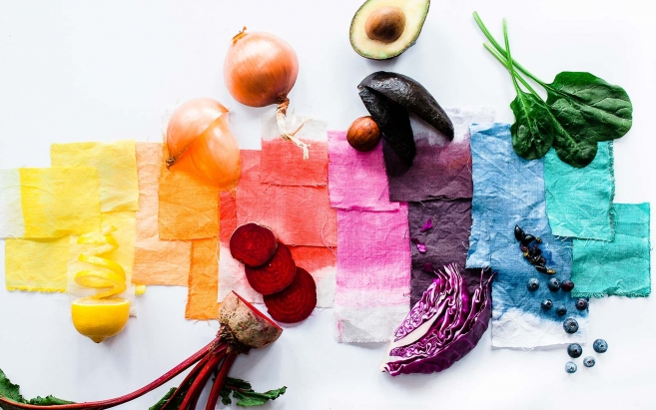
Notes:
What is the problem/challenge?
Our challenge today is to save make and reinvent – we're going to reuse food waste we find in our kitchen and turn it into inks that we can paint with
We need your help to use your Imagination muscles to help us think of ideas together. What kinds of things might help?
Ensure everyone understands the challenge/questions
Animate/visual understanding

Slide 13
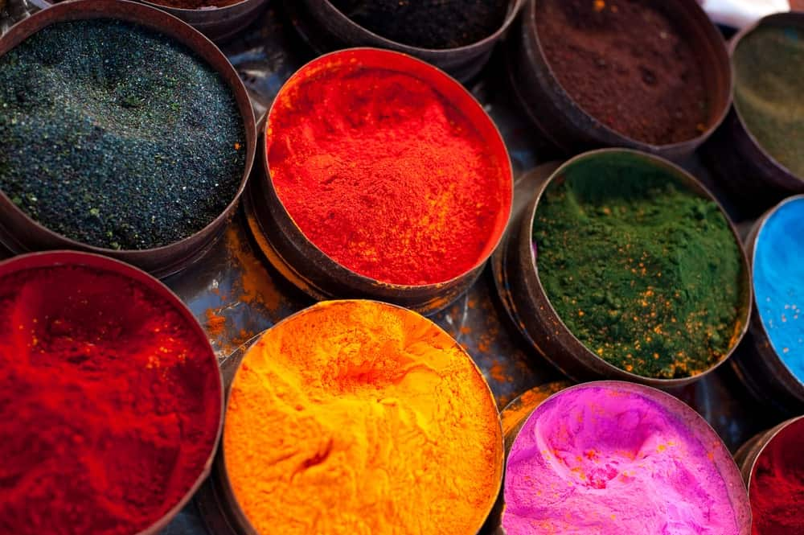

Slide 14
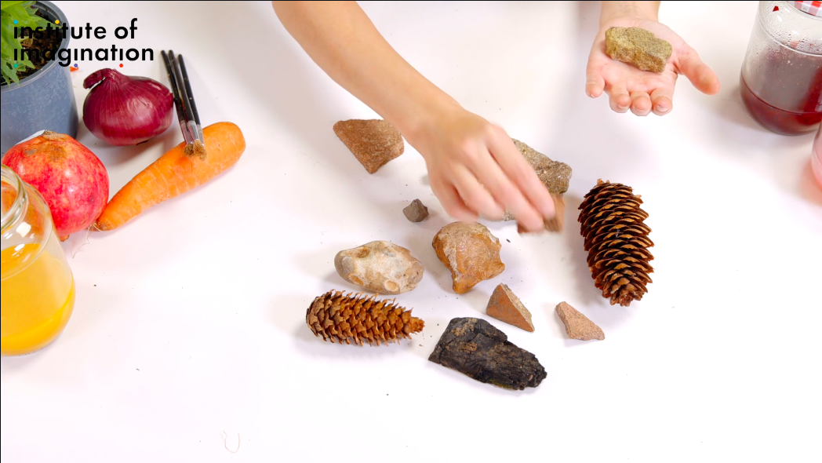
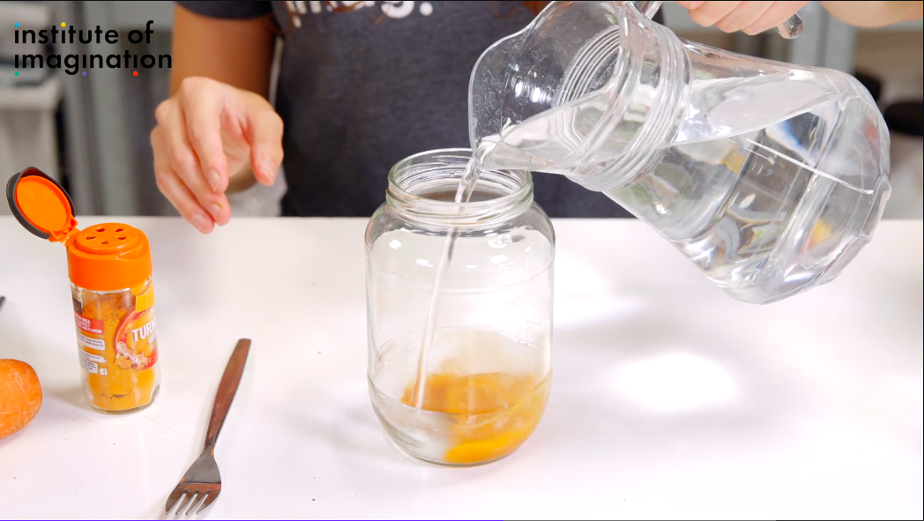
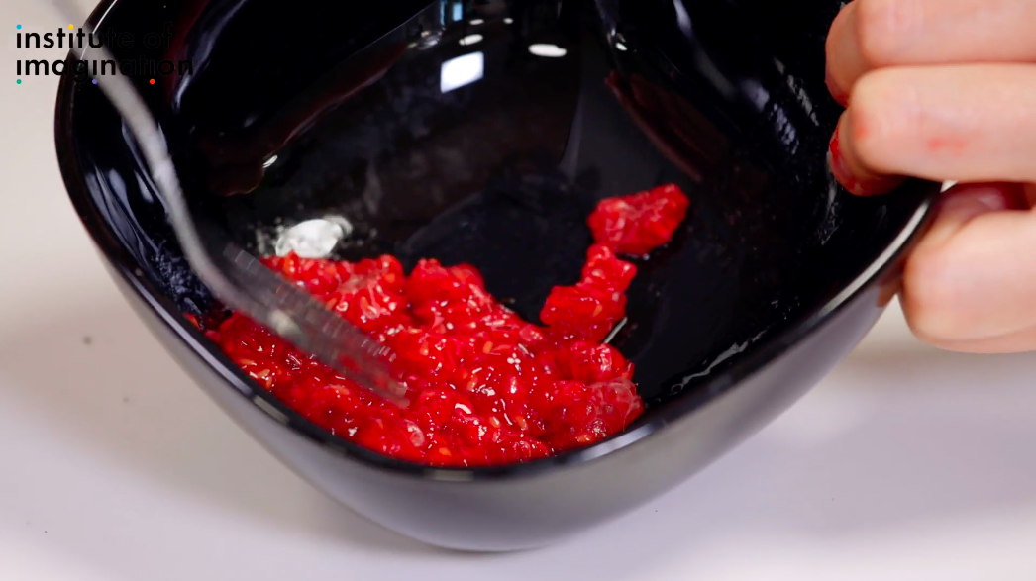
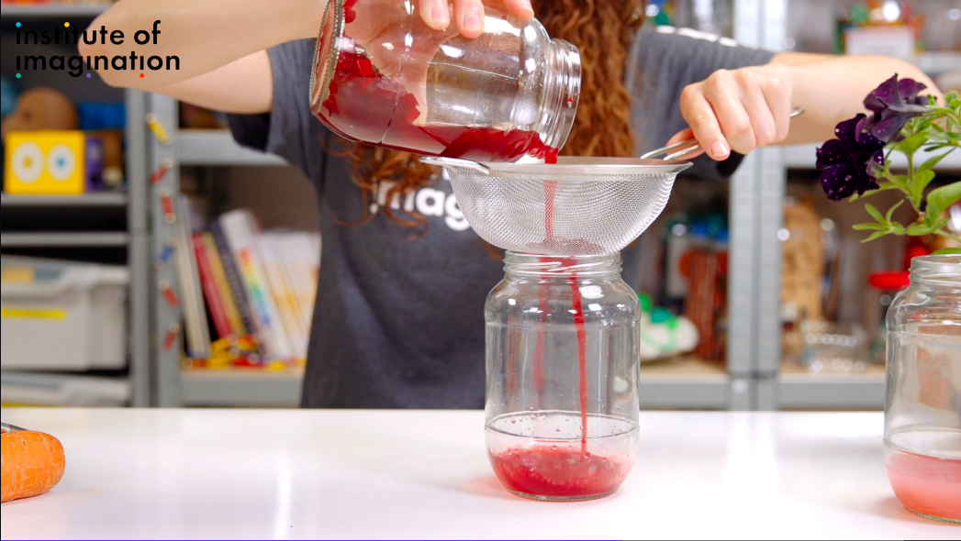
Notes:
Play video to give them an overview: https://home.ioi.london/watch/save-make-reinvent

Slide 15
Kettle (ask your adult to help with this part)
card
Food scraps
water
Lemon juice
bowls
honey
vinegar
pipette
spices
Bicarbonate of soda
Paint brush
Notes:
What you will need

Slide 16
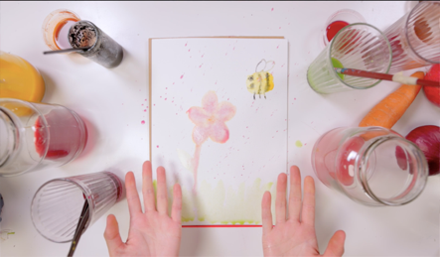
LET’S START MAKING!
Notes:
STEP 4: THE EXPLORATION (40 mins)
Experiment & Test with Techniques & Making
Share examples
Share how to do innovative techniques
Children, teachers and parents test and experiment
Can you show me what things you have brought to make ink?
See what children have brought. Inquire what colours they think we can make with that?
Start showing how to make ink:
Mixing; Show how they can use the pippets and put just a tiny amount of water to mix spices or other powder
Tea – Show them how you put the boiling water and you have to wait. You will do this
Using the pestle and mortar – how they can press flowers
Support the children if they need help.
Free creation of their art:
Allow children to explore with their colours and textures.
Explain that today we are painting our back drop for when we make our own film next in a couple of workshops time!
What do I mean by backdrop?
Imagine a place where your film will be set.
Ask children what they want to paint?

Slide 17
NOW TRY IT!
SEE WHAT HAPPENS WHEN YOU EXPERIMENT WITH ACIDS SUCH AS LEMON JUICE OR VINEGAR AND ALKALIS SUCH AS BICARBONATE OF SODA...

Slide 18
Show & Tell
Notes:
STEP 6: THE WOW MOMENT (15 mins)
Show & Tell
Children share the progress of their making in a show and tell.
Facilitators support children to reflect and progress
Ask the children to see their creations and observe how they are all different, there is not even one the same and you all had the same challenge. That is the beauty of imagination, we are all different, we all have our own ideas
Pick 2/3 children to explain their creation
Ask questions such as:
How did they make the colours?
How did you come up with that idea?
Did they find something difficult?
Ask children to close their eyes and to rase up their hands if:
Today they did something new
Today they learned something
Today they had fun
Encourage them to continue more making more things and to visit our website for more videos
Home.ioi.london

Slide 19
DIY Microscope
LET’S KEEP BUILDING
www.home.ioi.london

